Slide 1
Software Development Life Cycle
SDLC

Slide 2
What is covered?
What is SDLC?
Various stages of SDLC.
Different types of SDLC models.
Strengths and weaknesses.

Slide 3
What is SDLC?
SDLC The Software Development Life Cycle (SDLC), or System Development Life Cycle
It is applied in systems engineering, information systems and software engineering
It is the entire process of formal, logical steps taken to develop a software product.
The concept generally refers to computer or information systems development

Slide 4
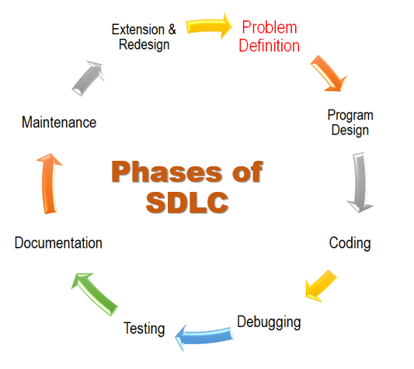
The phases of SDLC can vary somewhat but generally include the following in the diagram

Slide 5

Problem Definition
Problem definition is the basic and primary step of software development life cycle.
It includes the goal of system analysis and to determine where the problem is in an attempt to fix the system.
This step involves "breaking down" the system in different pieces to analyse the situation. Requirements Gathering is also a step to be taken in this stage.
Requirements Gathering sometimes requires individuals/teams from client as well as service providers to get detailed and accurate requirements.

Slide 6


Program Design
Design elements describe the desired software features in detail, and generally include functional hierarchy diagrams, screen layout diagrams, tables of business rules, business process diagrams, pseudo code, and a complete entity-relationship diagram with a full data dictionary.
The output of this stage will describe the new system as a collection of modules or subsystems.
The design stage takes the requirements as its initial input.

Slide 7
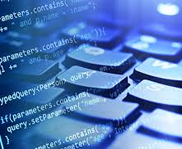
Coding
Modular and subsystem programming code will be accomplished during this stage.
Coding includes the application of various logic and internal work done by various specialists.
This stage is intermingled with the next in that individual modules will need testing before integration to the main project

Slide 8
Debugging
Debugging is the process of removing the errors that occurs during the coding part.
Debugging is essential for this stage as this establishes the platform for further stages of development.

Slide 9
Testing
The code is tested at various levels in software testing.
Unit, system and user acceptance testing are often performed.
This is a grey area as many different opinions exist as to what the stages of testing are and how much if any iteration occurs.

Slide 10

Documentation
Documentation is the process of writing down every stage and each and every detail of the process of life cycle development so that anyone who follows this process may be able to do it in the real sense.
Documenting the internal design of software for the purpose of future maintenance and enhancement is done throughout development.

Slide 11

Maintenance
Maintaining the system is an important aspect of SDLC.
As key personnel change positions in the organization, new changes will be implemented, which will require system updates.
Maintenance is the process of keeping the software in its fully functional form and see to that nothing goes wrong.
Maintaining and enhancing software to cope with newly discovered problems or new requirements can take far more time than the initial development of the software

Slide 12

Extension and Redesign
This is the last step of system design where there is always scope for extension and redesign whenever required.
This stage allows for the extension of any part for the advancement of the software so that the developed software does not become useless.
This stage allows further designing and following all the steps again.

Slide 13

Other models like SDLC
Different types of SDLC models: Several models exist to streamline the development process.
Each one, has its pros and cons, and it's up to the development team to adopt the most appropriate one for the project.
Sometimes a combination of the models may be more suitable.

Slide 14
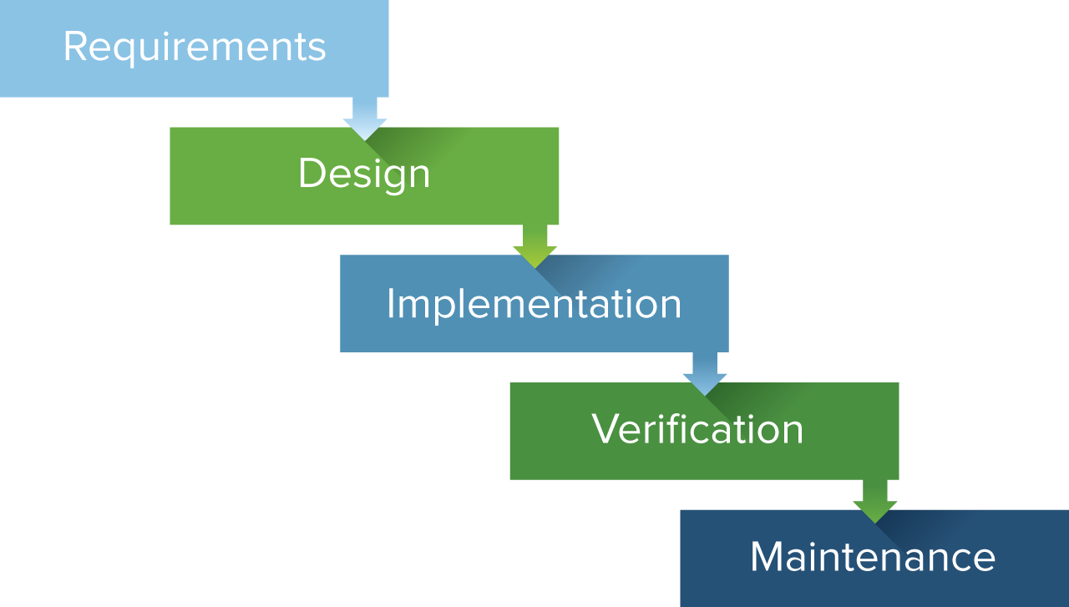
Other models for software development
WATERFALL MODEL
Based on sequential flow of the development.
The next phase doesn’t start until the previous step is fulfilled.
Each phase is mutually exclusive and does not overlap with each other

Slide 15
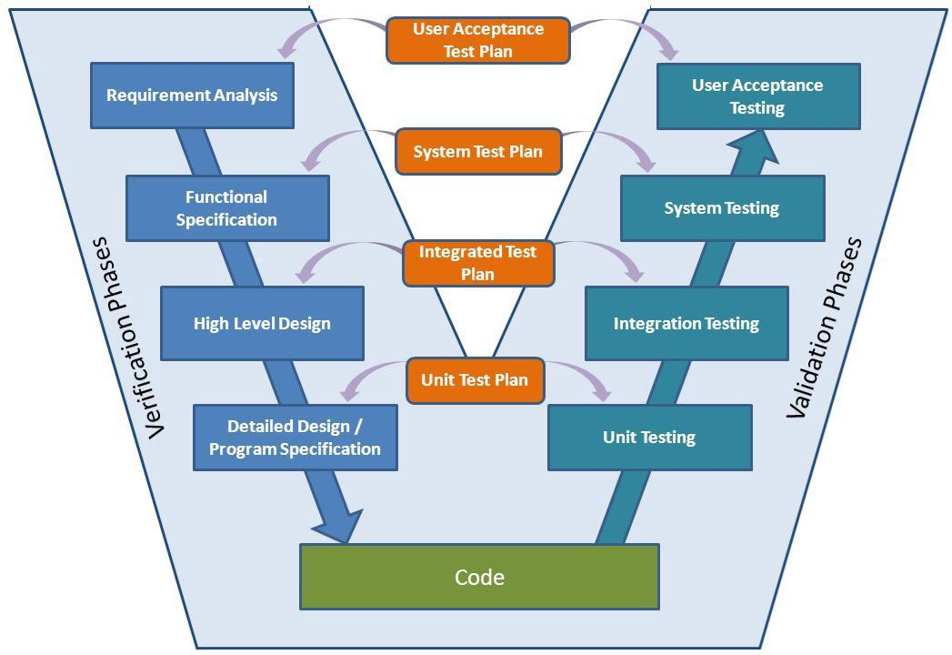
Other models for software development
V-Shape MODEL
Similar to waterfall model, but it has more focus on testing.
Each phase of software development lifecycle includes a distinct testing phase and deliverable.

Slide 16
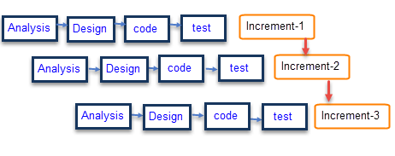
Other models for software development
Incremental Model
Requirements are divided into several stand-alone software development modules.
Subsequent release of the module adds a feature to the previous release.
The process will continue until the whole software is achieved.

Slide 17

Questions

